Slide 1
Visual Analytics Assignment
Vijay Shandilya

Slide 2
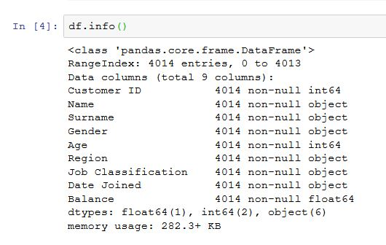
Objective : To find the key insights in the given data to know how to increase the revenue and reduce the cost .
Data Information:
1.Dropping Customer ID, Name ,
Surname and Date Joined from the
Data set as they contain multiple
Factor levels.

Slide 3
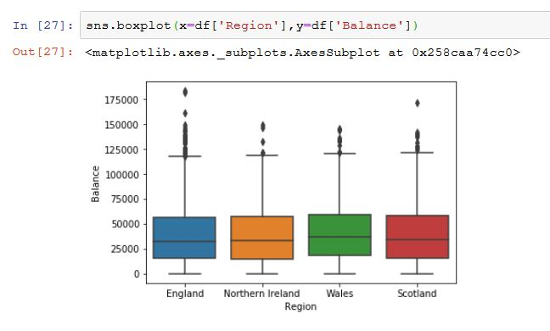
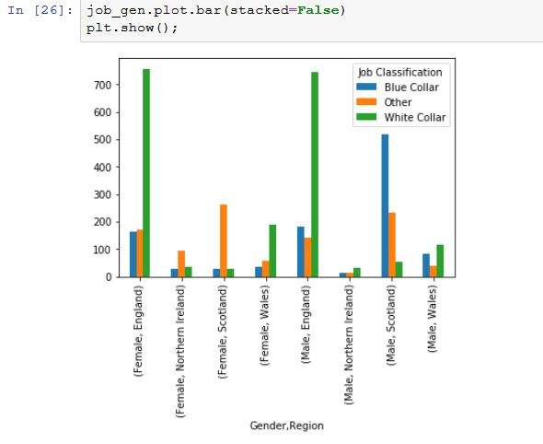
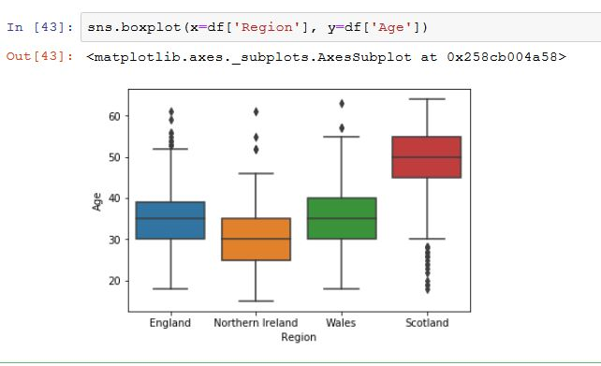
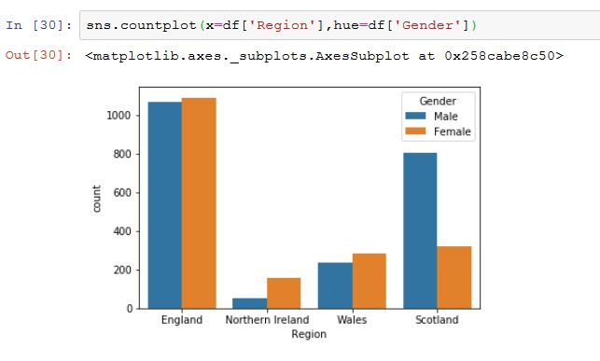
Insights:
Gender & Region v/s Job Class
Region v/s Balance
Region v/s Age
Region v/s Gender

Slide 4
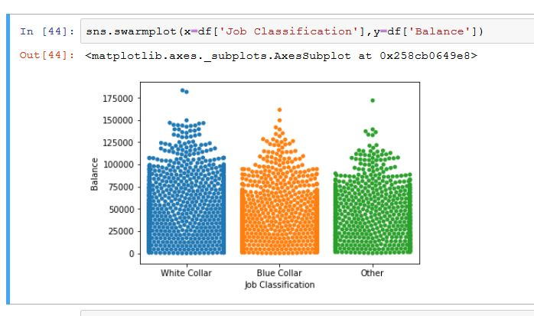
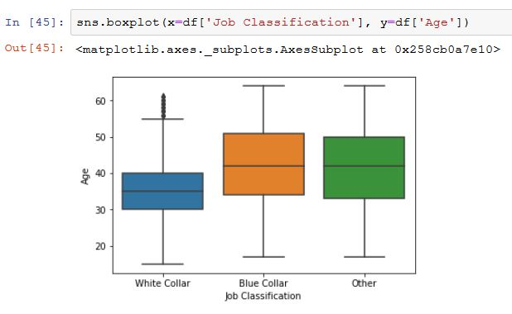
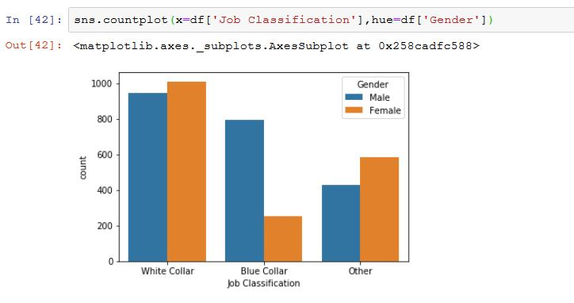
Insights:
Job Classification v/s Balance
Job Classification v/s Age
Job Classification v/s Gender

Slide 5
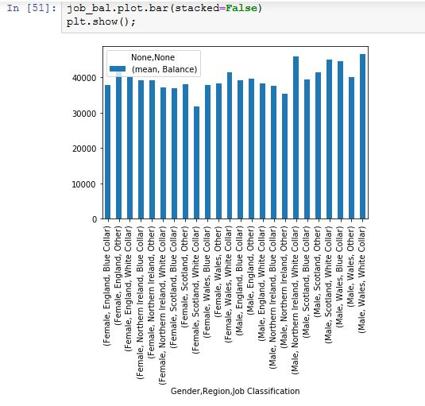
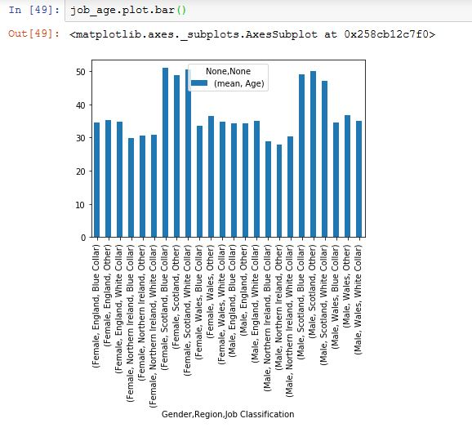
Insights:
Avg.Balance for gender and job category
Avg.Age for gender and job category

Slide 6
Insights:
Wales in spite of less population have the maximum average balance, following Wales Northern Ireland have second highest balance followed by Scotland and England.
Comparatively Northern Ireland have younger people followed by England, Wales and Scotland.
To increase the revenue bank should send the campaigning mail to the people of Wales and Northern Ireland to convince them to increase the deposit amount.
GITHUB LINK:
https://github.com/svijayshandilya/Visual_analatics

